Slide 1

Name : Rodina Ibrahim Mohamed

Slide 2
Contant
01
02
03
04
AVR
INT
(interrupt)
LCD
OSCIIISCOPE

Slide 3

Executive summary
Avr is connecting to interrupting button that will increase or decrease of duty cycle of high and low circuit
To detect the first rising edge is for int1and then count0 will detect to set time for rising to rising is in the second counter and the is the timer for all bored
For t_on it will be the threaded int and thread count
For t_off it going be 256-t_on

Slide 4
01
AVR

Slide 5
Company description
Architecture
Configuration
INTERFACING
Peripheral

Slide 6
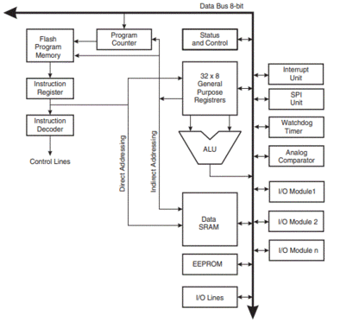
Architecture
1-32 General Purpose Registers
2-Special Function Registers
3-Static RAM
4-EEPROM
5-Flash
6-Timer/Counter
7-Compartor
8-Watch Dog timer
9-Protocols: UART, SPI, I2C
10-Interrupt Handler
11-IO Ports

Slide 7
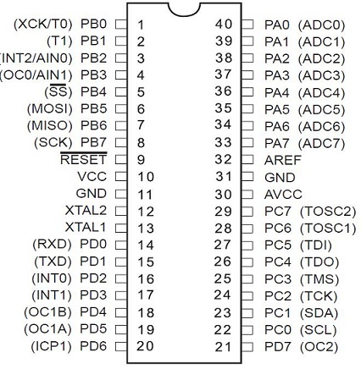
configuration

Slide 8
Interfacing
It interface to al peripheral that it existed into it Owen bored by programing and wiring
The layer is helping to modified the code and get to error easy and to serve will
Most commend is to
woke in layer way
that have 3-laryer
(MCAL_HAL_APP)
Interfacing is gone by
1-privet : reg and confg
2- .h :header
3- .c : fun

Slide 9
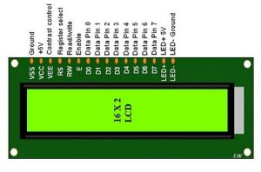
LCD

Slide 10
Business plan timeline
Pin confg
Connection
Interfacing
Play

Slide 11
Pin confg
 | Pin1 (Ground): | Pin4 (Register Select) |  | Pin7 (Data Pin)
 | Pin2 (+5 Volt) | Pin5 (Read & Write) |  | The data pins are from 0-7 which are connected through the microcontroller for data transmission. The LCD module can also work on the 4-bit mode through working on pins 1, 2, 3 & other pins are free. | Pin8 – Data Pin 1 Pin9 – Data Pin 2 Pin10 – Data Pin 3 Pin11 – Data Pin 4 Pin12 – Data Pin 5 Pin13 – Data Pin 6 Pin14 – Data Pin 7
 |  | This pin is used to read/write data.
 | Pin3 (VE) | Pin6 (Enable)
 | This pin selects the contrast of the LCD. | This enables the pin must be high to perform the Read/Write procedure. This pin is connected to the data pin of the microcontroller to be held high constantly.
Pin15 (LED Positive) |  |  | Pin16 (LED Negative):
This is a +Ve terminal of the backlight LED of the display & it is connected to +5V to activate the LED backlight. |  |  | This is a -Ve terminal of a backlight LED of the display & it is connected to the GND terminal to activate the LED backlight.

Slide 12
Code
1-int_fun
CAPTURE_FUN
INT1_FUN
while (1)

